Slide 1
U-Net
Group2
Posa, Malcolm, Addy

Slide 2
Introduction
Methodology
Results
Conclusions

Slide 3
Introduction:What is U-Net
·The U-Net architecture stems from the so-called “fully convolutional network” first proposed by Long and Shelhamer.
The main idea in U-Net is to supplement a usual contracting network by successive layers, where pooling operations are replaced by upsampling operators. Hence these layers increase the resolution of the output. What's more, a successive convolutional layer can then learn to assemble a precise output based on this information.
In short, U-Net is a encoder-decoder style network architecture.
Notes:
One important modification in U-Net is that there are a large number of feature channels in the upsampling part, which allow the network to propagate context information to higher resolution layers.

Slide 4
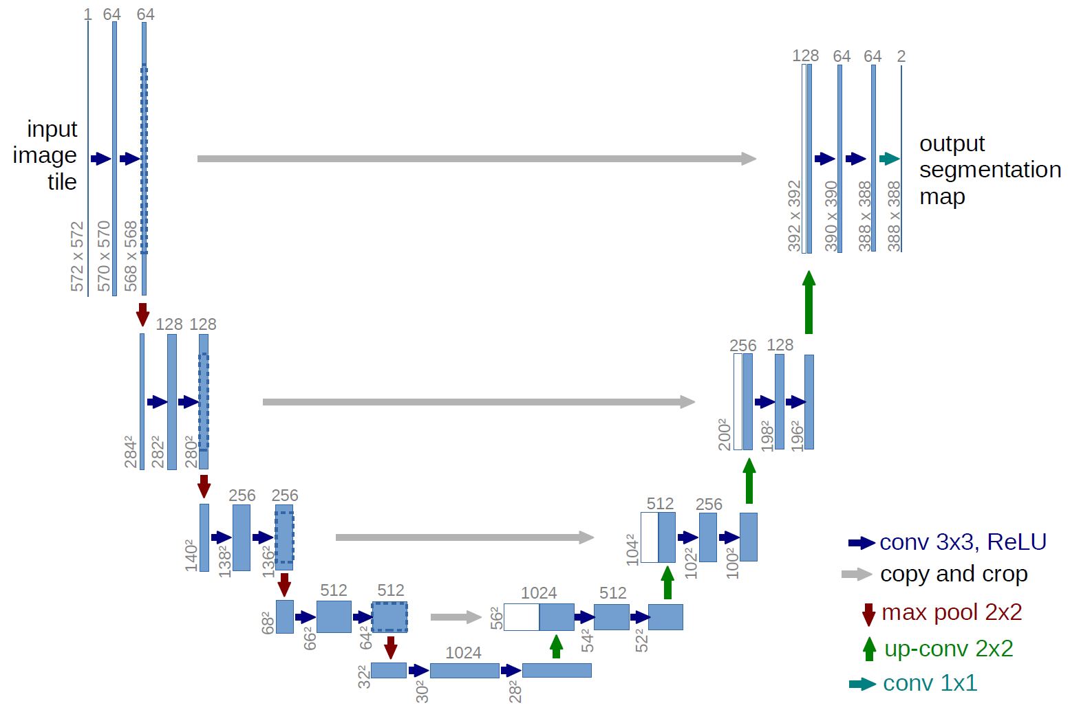
Introduction: How U-Net works
Notes:
Both input and output is a picture
输入是一幅图，输出时目标的分割结果
The architecture consists of a contracting path to capture context and a symmetric expanding path that enables precise localiza- tion, bottle neck
U-net architecture (example for 32x32 pixels in the lowest resolution). Each blue box corresponds to a multi-channel feature map. The number of channels is denoted on top of the box. The x-y-size is provided at the lower left edge of the box. White boxes represent copied feature maps. The arrows denote the different operations.
It consists of a contracting path (left side) and an expansive path (right side). The contracting path follows the typical architecture of a convolutional network:
two 3x3 convolutions (unpadded convolutions), each followed by (ReLU) and a 2x2 max pooling operation with stride 2 for downsampling. At each downsampling step we double the number of feature channels. Every step in the expansive path consists of an upsampling of the feature map followed by a 2x2 convolution (“up-convolution”) that halves the number of feature channels, a concatenation with the correspondingly cropped feature map from the contracting path, and two 3x3 convolutions, each followed by a ReLU. The cropping is necessary due to the loss of border pixels in every convolution. At the final layer a 1x1 convolution is used to map each 64- component feature vector to the desired number of classes. In total the network has 23 convolutional layers

Slide 5
Methodology: Dataset
Name:
Segmentation of OCT images(DME):
Description:
A platform provide for the data scientist to do machine learning, competition, and code sharing.
Total size:
203.7 MB
Train data dimension:
X_train.shape:(None ,496, 768, 1)
Notes:
糖尿病黄斑水肿的光学想干断层扫描图像分割图像

Slide 6
Our codes
U-Net is a fully convolutional network that is used for image segmentation.
lts architecture uses the following types of layers:
Conv2D - Simple convolution layers, with padding and 3x3 kernel
MaxPooling2D - Simple MaxPooling layers, 2x2 kernel
Dropout - Effectively prevent overfitting, large neural networks will cause overfitting when training on small data sets
Concatenate - layer used to concatenate multiple feature maps from different stages of training
UpSampling2D - layer that increases size of feature map
Total params: 65,961
Batch size: 11
Epochs: 20
Using GPU: GeForce GTX 1060

Slide 7
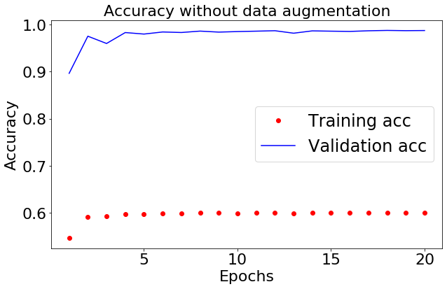
Results
The training accuracy is relatively low, but the validation is high, which is nearly 0.98.

Slide 8
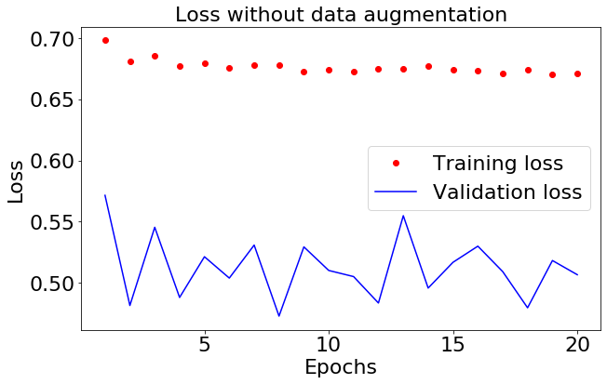

Slide 9
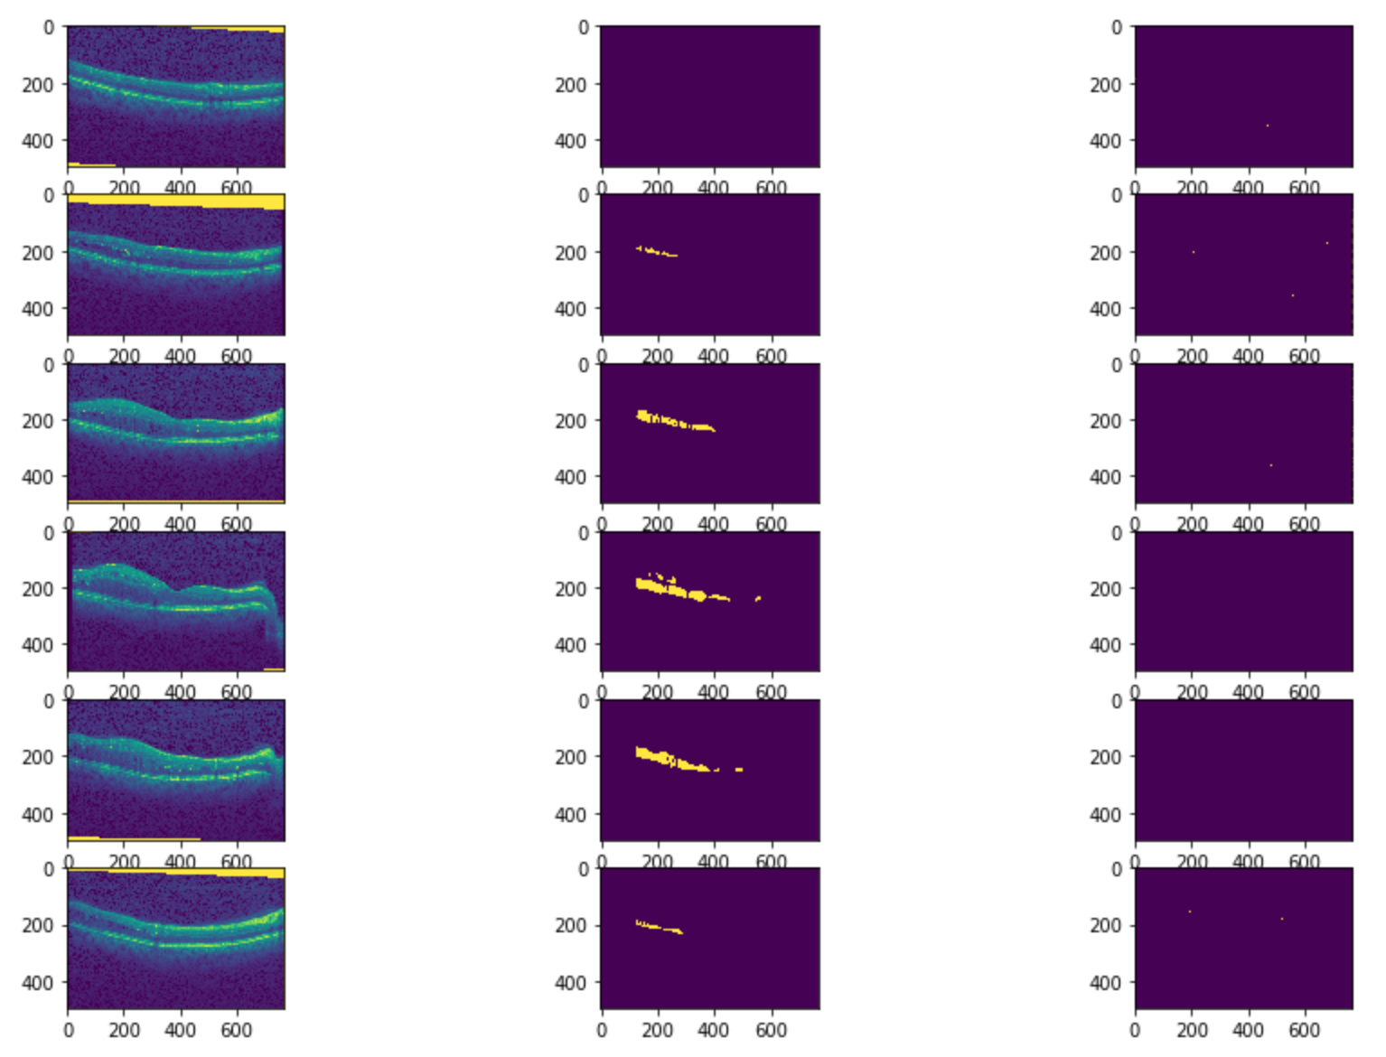
Plot the results
Since the dataset which the blog gives us is lack in data, which means that they only have 100 samples.
So the results may be not good as the plot shows.

Slide 10
CNN VS U-net in semantic segmentation
CNN trains a network in a sliding-window setup to predict the class label of each pixel by providing a local region (patch) around that pixel as input.
However, this strategy has two drawbacks.
First, it is quite slow.
Secondly, there is a trade-off between localization accuracy and the use of context.

Slide 11
Why U-Net ?
The skip connection method in U-Net supplements the loss of border pixels in every convolution by implementing cropping. It concatenates the low-resolution(lower layer features) and high-resolution(upper layer features) information which leads to a much more accurate segmentation.
The output dimension is nearly the same as the input.
Notes:
Convolutional Neural Networks gave decent results in easier image segmentation problems but it hasn't made any good progress on complex ones. That’s where UNet comes in the picture. UNet was first designed especially for medical image segmentation. It showed such good results that it used in many other fields after.
The reason why Unet is very useful in image segmentation is the skip connection method.
The network does not have any fully connected layers
matched lower and upper features after cropping lower feature（The cropping is necessary due to the loss of border pixels in every convolution.
High accuracy given proper training, adequate dataset and training time;

Slide 12
Any Questions or Comments?

Slide 13
Thanks for listening！
Ziqi Guo
Mingze Ma
Yisheng Sun

